Slide 1


Group 5
Happy Hour App
Gian Jalaan
Mario Arraya
Justin Ramos
Carden Pierre
Rita Ilchenko

Slide 2
Group 5
Why Happy Hour App?
Gian Jlaan
Mario Arraa
Justin Ramos
Carden Pierre
Rita
Big cities has a lot of bars
Which bar has happy hour menu?
Real time menu price information
Dead Bar vs ”Hot” Bar

Slide 3
Group 5
API’s & Frameworks
Gian Jlaan
Mario Arraa
Justin Ramos
Carden Pierre
Rita
Map - Google API
Real Time Database – Firebase
Authentication – Firebase
Programming Languages: HTML, CSS, Bootstrap/Purpose and Java script

Slide 4
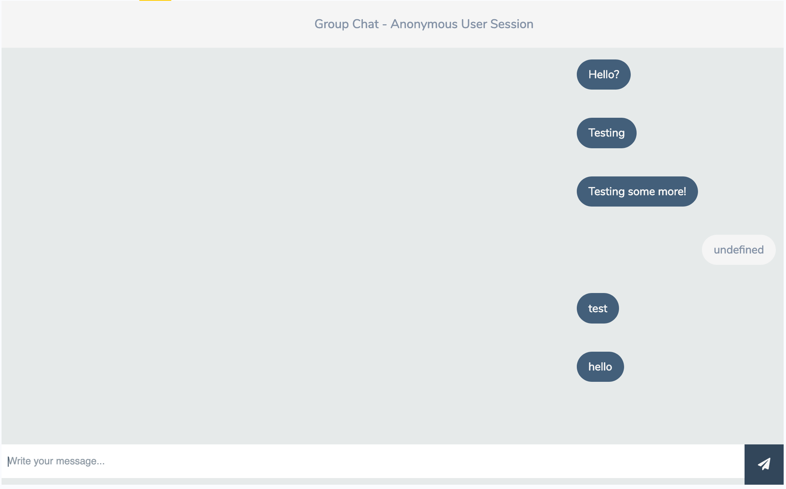
Group 5
Chat
Gian Jlaan
Mario Arraa
Justin Ramos
Carden Pierre
Rita

Slide 5
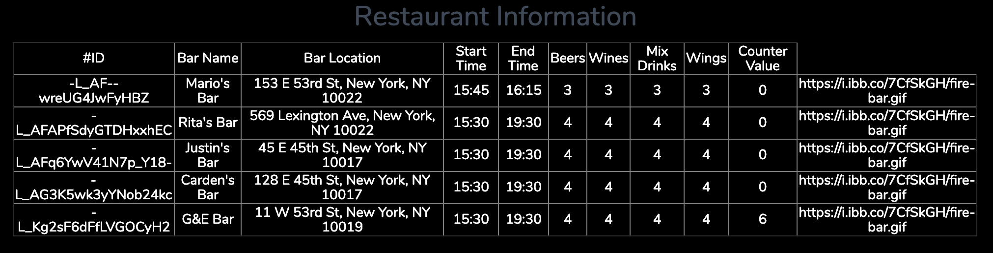
Group 5
Bar Owner’s View
Gian Jlaan
Mario Arraa
Justin Ramos
Carden Pierre
Rita

Slide 6
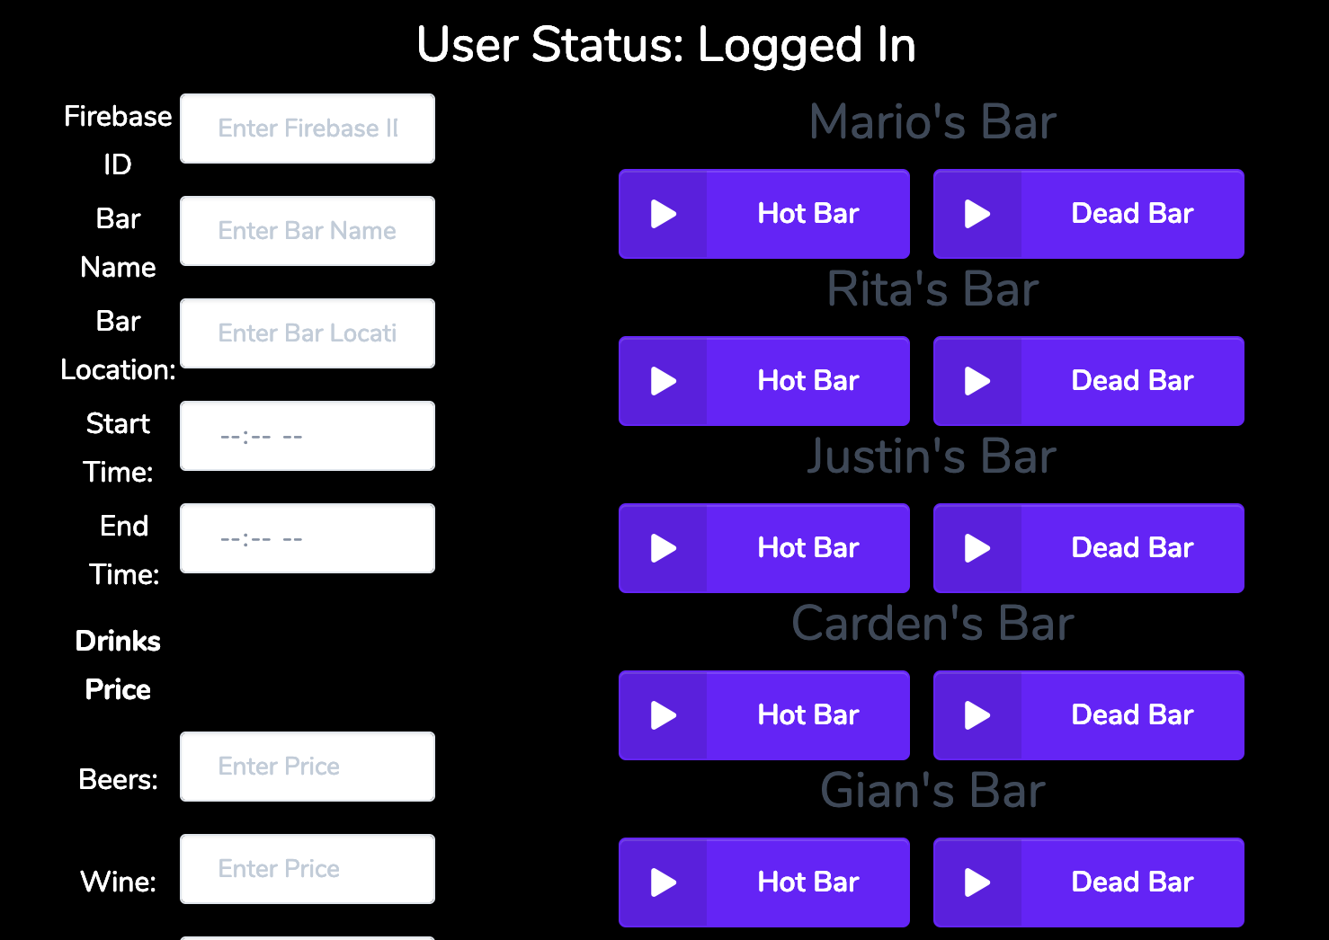
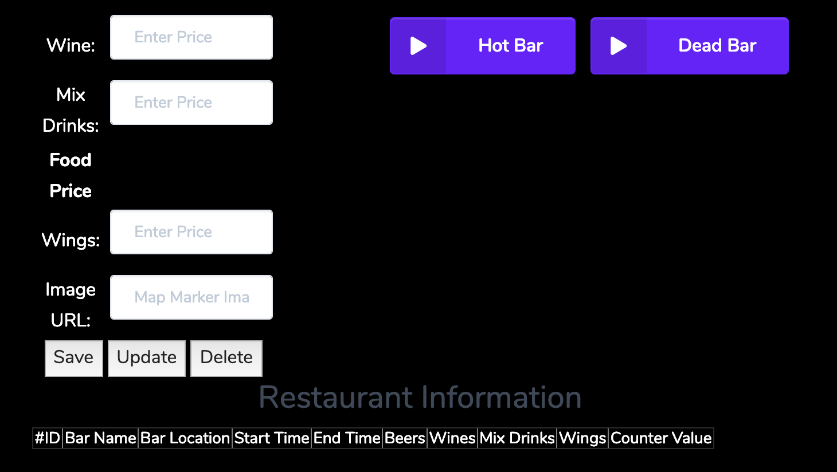
Group 5
Bar Owner’s View cont.
Gian Jlaan
Mario Arraa
Justin Ramos
Carden Pierre
Rita

Slide 7
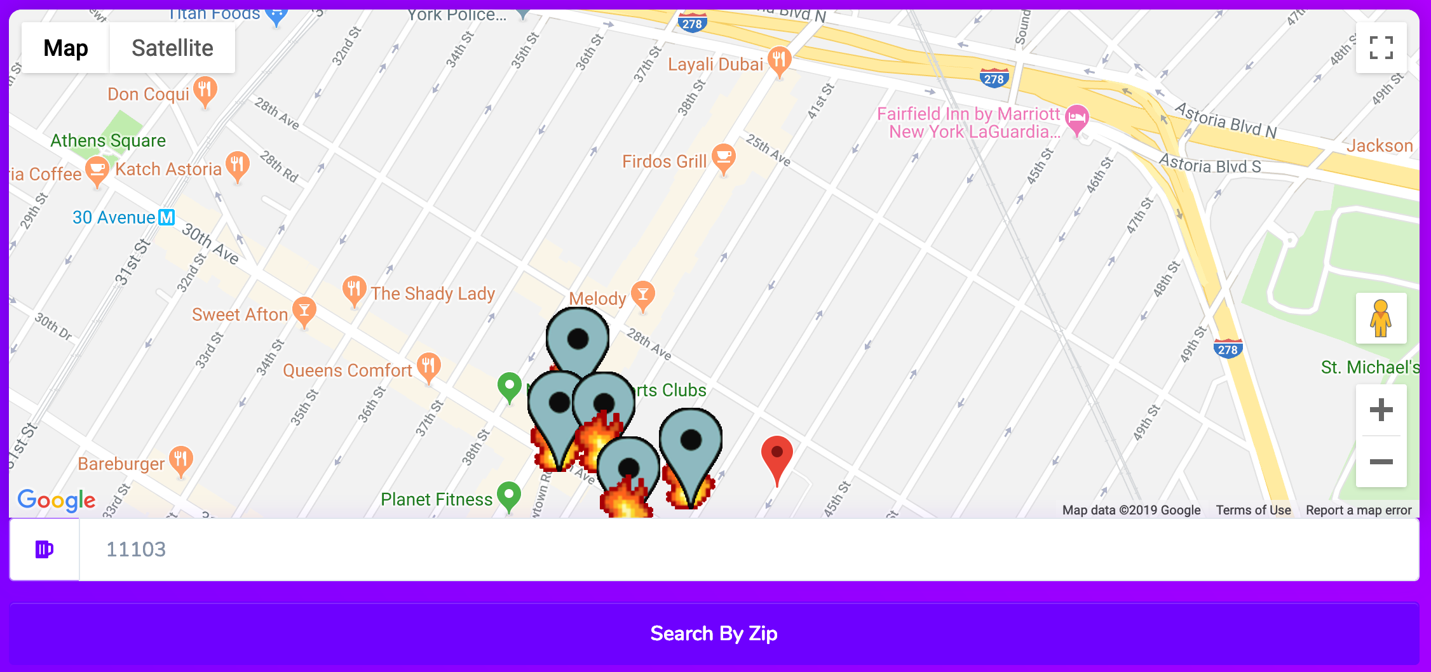
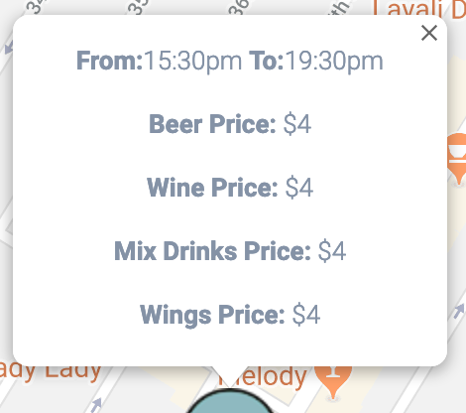
Group 5
User Map View
Gian Jlaan
Mario Arraa
Justin Ramos
Carden Pierre
Rita

Slide 8
Group 5
Future Development
Gian Jlaan
Mario Arraa
Justin Ramos
Carden Pierre
Rita
Review Feature
Categorize markers by drink prices
Integrate the chat function
View Tracker

Slide 9
Group 5
Challenges
Gian Jlaan
Mario Arraa
Justin Ramos
Carden Pierre
Rita
Github
Communication
Working with different API’s

Slide 10
Group 5
Gian Jlaan
Mario Arraa
Justin Ramos
Carden Pierre
Rita
Demonstration

Slide 11
Group 5
Gian Jlaan
Mario Arraa
Justin Ramos
Carden Pierre
Rita
Question/s?

